Slide 1
CO2301 - Games Development 1
Week 1
Introduction to AI
Gareth Bellaby

Slide 2
Topics
Introductory material
Complexity and Knowledge Representation
Knowledge Representation

Slide 3
Topic 1
Introductory material

Slide 4
Characteristics of the Second Year
Possibly the most difficult of the three years.
A lot of material to learn.
But getting to the heart of the material.

Slide 5
Resources
If you haven't already got these you must buy:
Rabin, Steve, (ed.), (2005), Game Development, Charles River Media. ISBN-13: 978-1584503774
van Verth, James, (2008), Essential Mathematics For Games & Interactive Applications: A Programmer's Guide Book, 2nd ed., Morgan Kaufmann. ISBN-13: 978-0123742971
The maths book has an associated web site:
http://www.essentialmath.com/tutorial.htm

Slide 6
Resources
The other two books I recommend for the module are:
Russell, Stuart & Norvig, Peter, (2003), Artificial Intelligence: A Modern Approach, (International Edition), Pearson Education. ISBN-13: 978-0130803023
Ahlquist, John, (2007), Game Development Essentials: Game Artificial Intelligence, Delmar. ISBN-13: 978-1418038571

Slide 7
Others Resources
Many good textbooks about AI - look in the library.
Games AI Wisdom series. Edited by Steve Rabin.
Game Programming Gems, Edited by Mark DeLoura and others.
http://www.gamasutra.com/
http://www.gameai.com/
http://www.ai-junkie.com/ai-junkie.html
http://www.aiwisdom.com/index.html
http://ai-depot.com/

Slide 8
AI in the module
Movement
Targeting
Basics of turning, avoidance, patrolling
Pathfinding
Software agents - main model used for FPS, racing type games, or for bots.
Finite State Machines

Slide 9
AI Overview
Introduction to AI, Knowledge and Representation
Game Agents 1
Game Agents 2 (Sensing: Vision and Hearing)
Finite State Machines + Maths
LookAt + Graph Theory
Introduction to Pathfinding, Crash and Turn, Breadth-First search
Second year project week - no classes

Slide 10
AI Overview
Depth-First search, Combinatorial Explosion, Heuristics, Hill-climbing
Best-First, Dijstra's algorithm. Distances, graphs and lines
A*
Search methods
Interpolation (Path Smoothing, splines)
Pathfinding Considerations (Final comments on algorithms, Representations
Revision. Planning, resistance, threats, etc??

Slide 11
Topic 2
Complexity and Knowledge Representation

Slide 12
What is AI?
Phrase invented by John McCarthy in 1956. However, earlier thinkers already examining, e.g. Turing.
Decision making, automation, artificial minds... a rag-bag of unrelated problems? What is intelligence? The definition of AI is an ongoing debate which reflects the nature of the subject.
Games - by way of contrast: a practical approach to AI.

Slide 13
Representation & Reasoning
There are a variety of knowledge representation methods.
Most AI is based on symbol manipulation, i.e. a set of symbols with a set of procedures for operating on them.
Knowledge is representation and the methods for manipulating it.
Facts are the things we want to represent.
Representations of the facts are what are being manipulated.

Slide 14
Knowledge Representation
Representation matters a great deal. A poor representation can make things impossibly difficult. A good representation can make reasoning easier.
One important topic of game AI is pathfinding. Imagine movement around a level in a game.
Describe the level using the coordinates of the walls, position of objects, etc. Use collision detection to calculate whether the agent is blocked.
Such a poor representation would lead to complex and difficult calculations.

Slide 15
Knowledge Representation
A simplified representation of the world is used, e.g.
  A square grid with only horizontal and vertical movement.
  Waypoints interconnected by lines.
  Regions.
It is difficult to reason about the real world.

Slide 16
Map design
The AI developer should work closely with the level designer. This relationship may include the artists as well.
Change the design of the level to work with the AI.
Simplify the world - don't include features which are difficult to navigate.
Convex is better than concave.

Slide 17
Halo
Articles can be found here:
http://www.bungie.net/Inside/publications.aspx
Damian Isla (AI Engineering Lead)
"Halo AI Retrospective: 8 Years of Work on 30 Seconds of Fun"

Slide 18
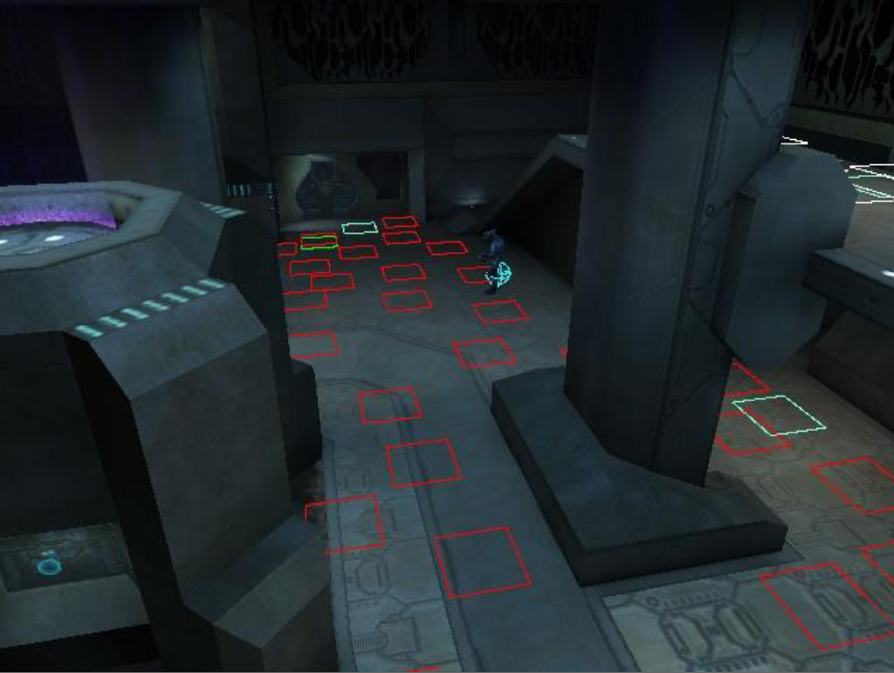
Halo

Slide 19
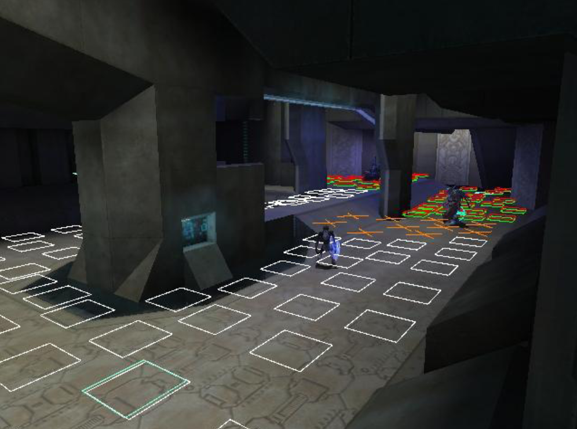
Halo

Slide 20
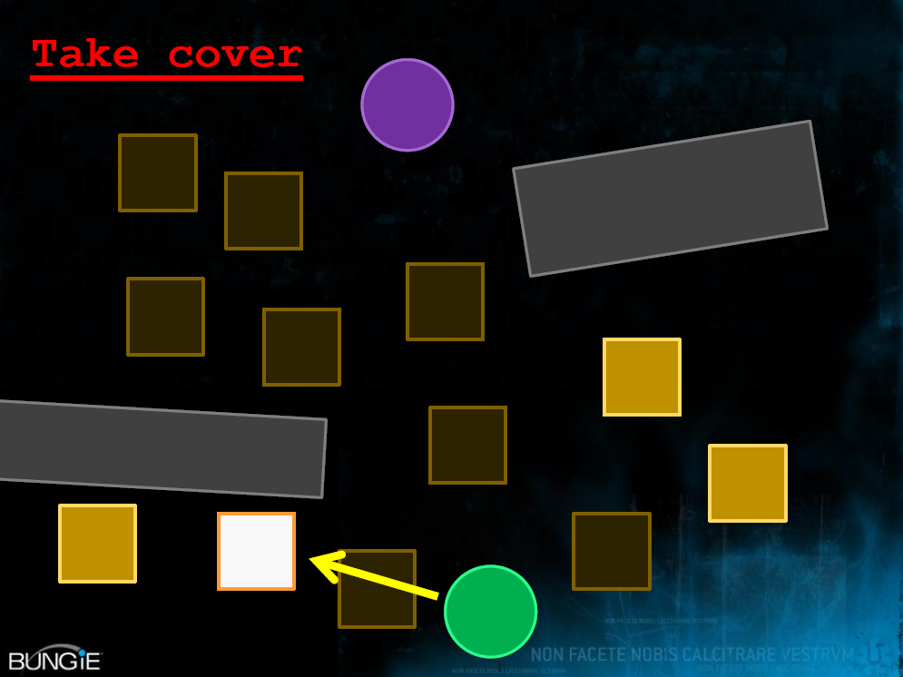
Halo

Slide 21
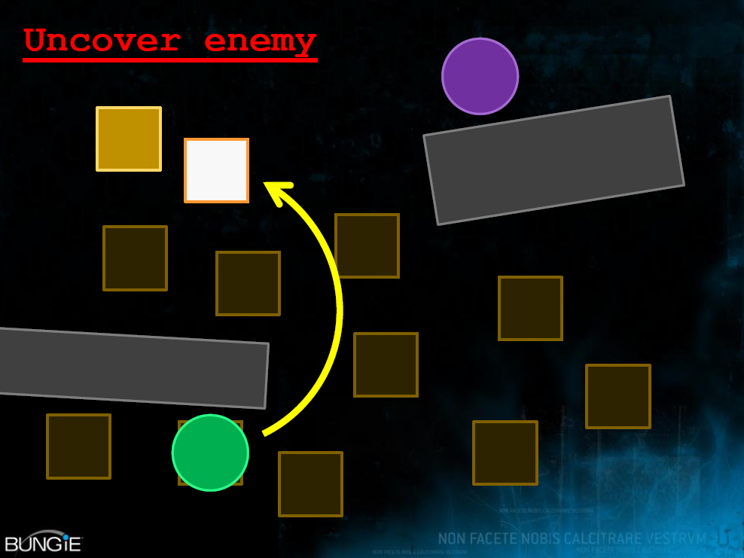
Halo

Slide 22
Halo
Video.
Action sped up to twice normal speed.

Slide 23
Topic 3
Knowledge Representation

Slide 24
Knowledge Representation
A good representation can make reasoning not only correct but trivial.
Example: the mutilated chess board problem.
A normal chess board has had two squares in opposite corners removed. Can you cover all the remaining squares exactly with dominoes? Each domino covers two square. No overlapping of dominoes, either on each other or over the boundary is allowed.

Slide 25
Board Representation (1)

Slide 26
Board Representation (2)

Slide 27
Board Representation (3)
Number of black squares = 30
Number of white squares = 32

Slide 28
Knowledge Representation
The third representation method directly suggests the answer, along with the additional specification that each domino must cover exactly one black and one white square.
The second method is (typically) better than the first.
Representation therefore can make a big difference. If the representation is not good, a program may not be able to produce the desired results.

Slide 29
Knowledge Representation
Good systems should have:
Representational adequacy.
Inferential adequacy.
Inferential efficiency.
Acquisitional efficiency.
Perhaps not possible to optimise all four.

Slide 30
Knowledge Representation
A set of facts can be represented in a database. However, a database has very low inferential capabilities. It might be possible to use an inference engine (cf. Data Mining).
Database: static, flat, homogenous, passive.
Knowledge Base: flexible, layered, heterogeneous, active.

